Slide 1
Basic Electrical and Electronics Engineering
Dr. Sonam Shrivastava/ Assistant Professor (Sr.) /SELECT
LECTURE 1.6

Slide 2
Nodal Voltage Analysis
Steps to Determine Node Voltages:
Select a node as the reference node. Assign voltages v₁, v₂, . . . , v_{n−1} to the remaining n − 1 nodes. The voltages are referenced with respect to the reference node.
2. Apply KCL to each of the n − 1 nonreference nodes. Use Ohm’s law to express the branch currents in terms of node voltages.
3. Solve the resulting simultaneous equations to obtain the unknown node voltages.

Slide 3
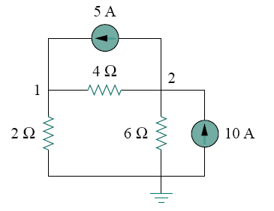

Slide 4






Q. Calculate the node voltages in the circuit shown in Fig.
At node 1, applying KCL and Ohm’s law gives
Multiplying each term in the last equation by 4, we obtain
At node 2, we do the same thing and get
(1)
Multiplying each term by 12 results in
(2)

Slide 5

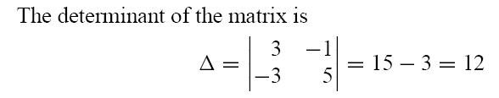
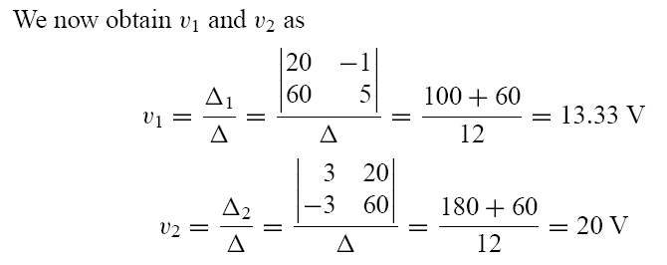
To use Cramer’s rule, we need to put Eqs. (1) and (2) in matrix form as

Slide 6
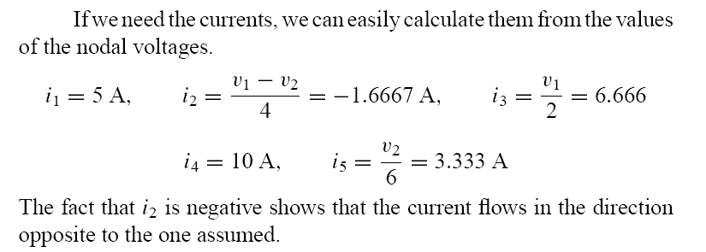

Slide 7
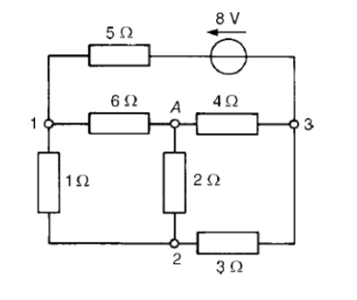

Slide 8
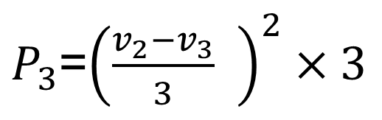





QUESTION
$$v_{1}=1.2177 Volts$$
$$v_{2}=0.37889 Volts$$
$$v_{3}=−1.5712 Volts$$
$i_{2}=\frac{v_{2}}{2}=0.19 A$
$P_{3}$=${\left(\frac{v_{2}−v_{3}}{3} \right)}^{2}×3$
$$P_{3}=1.267 W$$

Slide 9
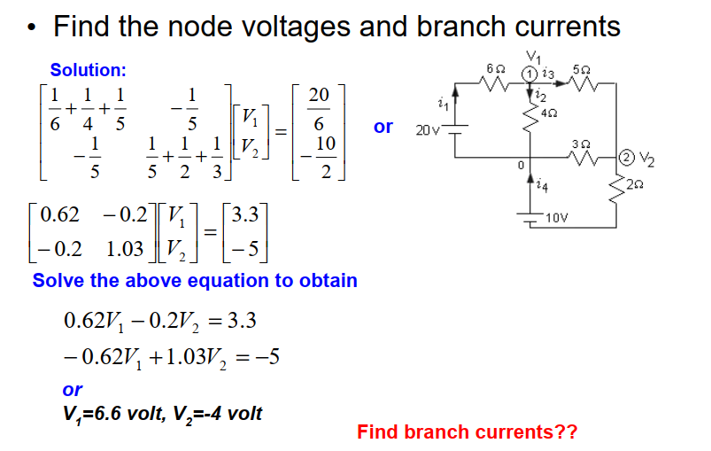
QUESTION

Slide 10
QUESTION

Slide 11
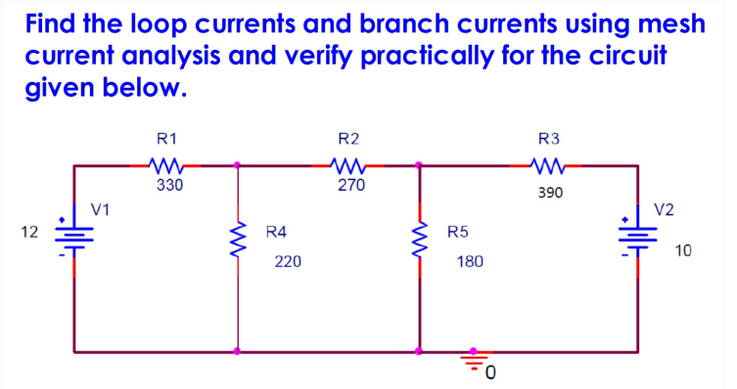
QUESTION

